Slide 1



Akshata Bodhankar
Pranshu Jaryal

Slide 2



Problem DNA
Current State
A large international hotel chain wants to venture into the field of medical tourism
The company wants to confirm that this market is sustainable and that they can start their hotel or acquire one in Taiwan
What can the future course of action for the company look like?
Future State
The company has successfully ventured into medical tourism industry
The team created a framework to help identify and optimize the businesses in medical tourism in which to invest
The team has identified the factors to leading to investment in medical tourism in Taiwan
Gap
What factors influence medical tourism?

Slide 3
Representation
What factors influence medical tourism?
Medical industry
Travel industry
Hospitals & Clinics
Drugs
Healthcare professionals
Equipment
Accessibility
Hotels
Location
Number of hospitals & clinics
Number of beds
Online presence
Ranking/rating
Locations
Flights
Ships
Public transport
Cost of drugs
Number of drugs
Rating
Number of rooms
Cost
Number of doctors per hospital
Ranking & rating
Proximity to hospitals
Activities
Types
Count
Quality

Slide 4

We identify the questions to be answered
Current State
A large international hotel chain wants to venture into the field of medical tourism
The company wants to confirm that this market is sustainable and that they can start their hotel or acquire one in Taiwan
What can the future course of action for the company look like?
Future State
The team has successfully ventured into medical tourism industry
The team created a framework to help identify and optimize the businesses in medical tourism in which to invest
The team has identified the factors to leading to investment in medical tourism in Taiwan
Questions
Is there significant growth in medical tourism industry in Taiwan?
Which county has the highest number of hotels and hospitals?
Which companies can be invested in?

Slide 5




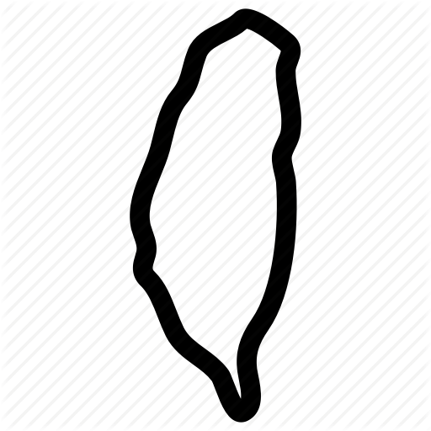





One of the reasons why people visit Taiwan is medical
exhibition
study
tourist
relatives
TW
pleasure
medical
conference
business

Slide 6
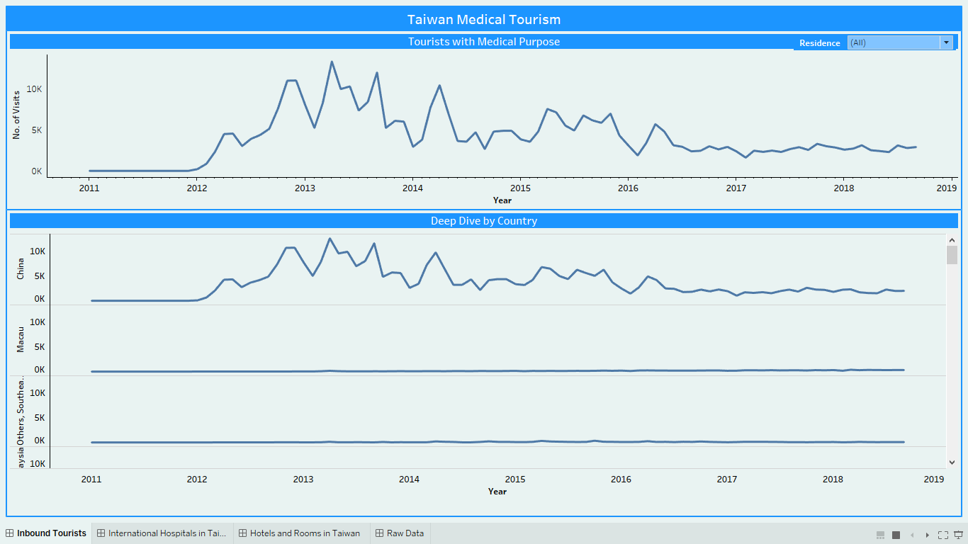
Problem DNA
Most medical tourists were from China

Slide 7
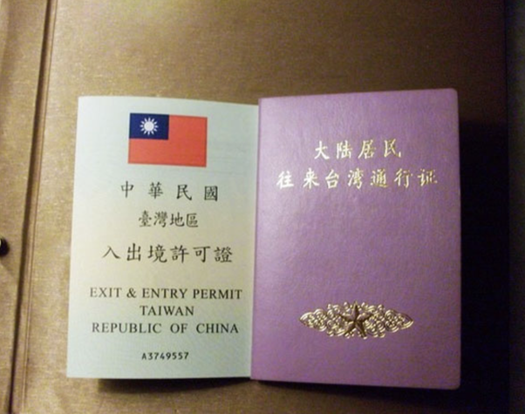
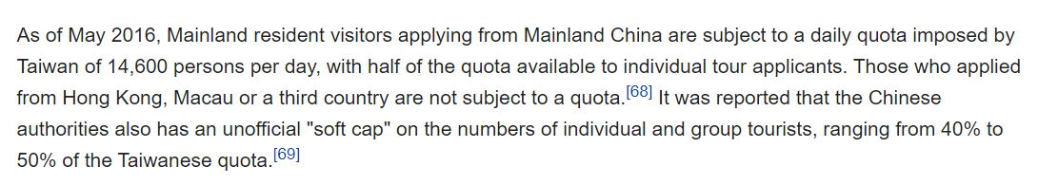
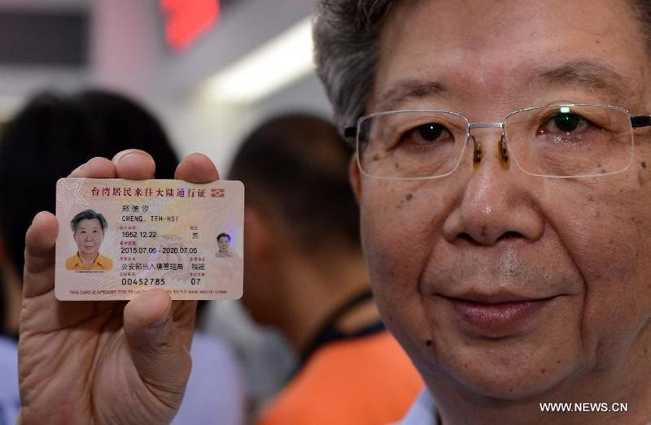
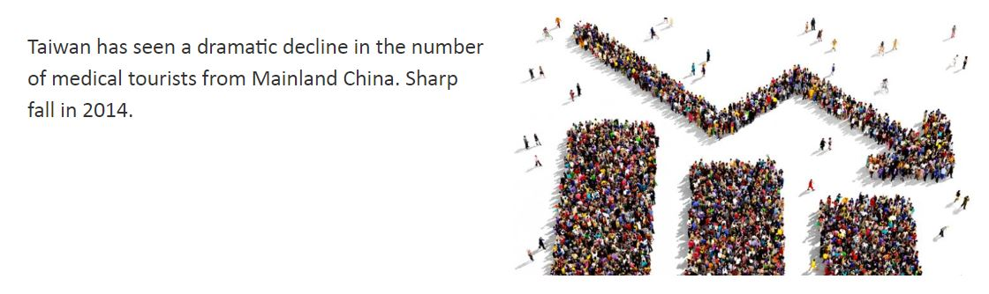
Travel permits caused the Chinese to stop traveling to Taiwan

Slide 8
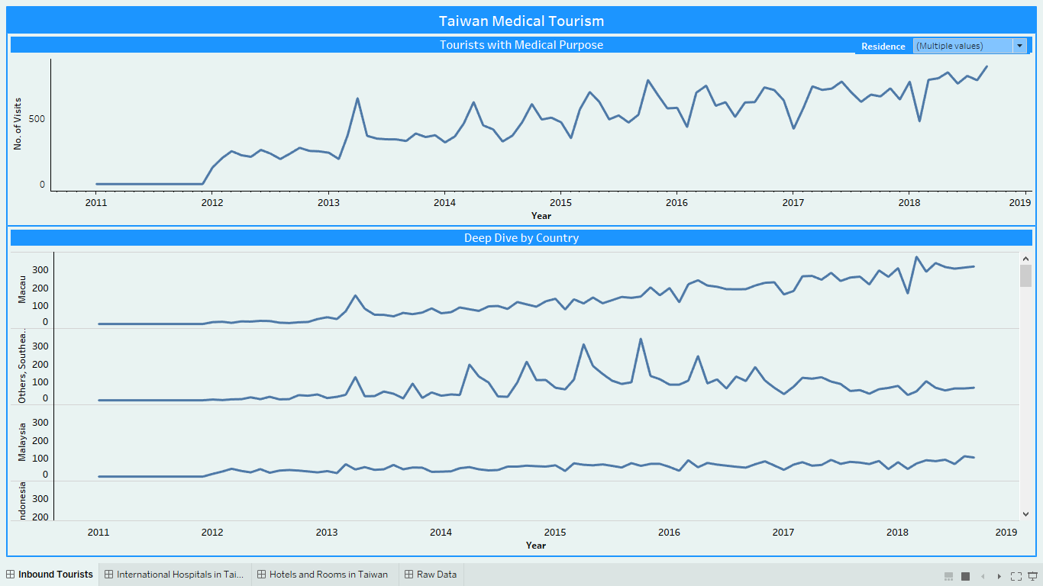
Taiwan also saw large inbound tourists from Macau
and other southeast Asian countries

Slide 9
But, there is an overall significant increase in medical tourism over a span of 5 years
Rise in number of tourists over a span of 5 years for medical purposes at significance level of 95%, from all countries except China and some countries in Southeast Asia makes it worthwhile to invest in Taiwan’s tourism industry
The number of inbound tourists from Macau are far greater than those from other countries included in the above test
Taiwan sees a drop in number of tourists from China due to the visa regulations introduced by China in July 2017
Tourists from several southeast Asian countries have been increasing in number significantly from 2012 to 2015 but not so later on. The rise is however, significant over a span of 5 years.
Note:
P-value | Countries
0.9959 | China
1.79e-05 | Others, Southeast Asia
0.0006 | Macau
0.00052 | Other countries

Slide 10
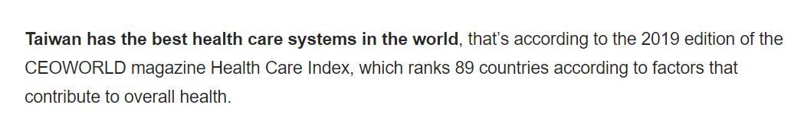
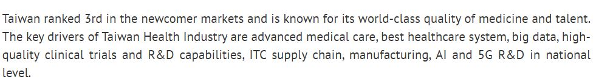
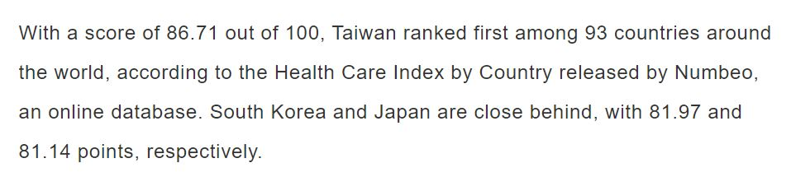
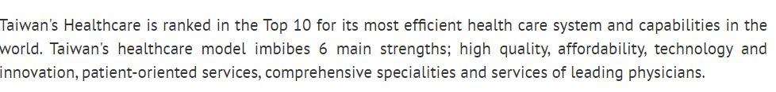

Despite this, Taiwan became leader in world healthcare system

Slide 11
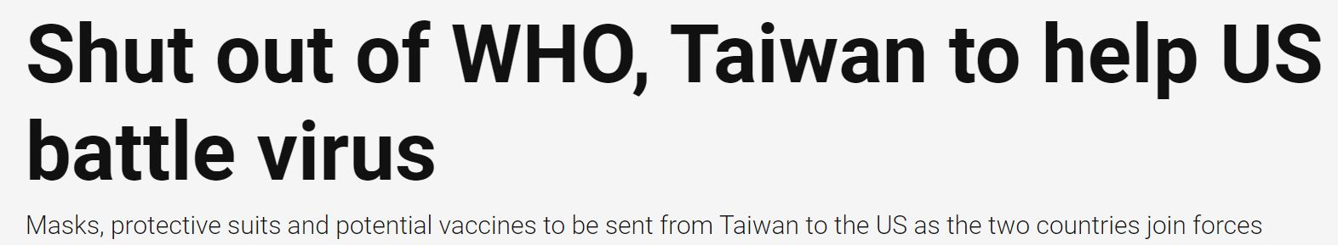
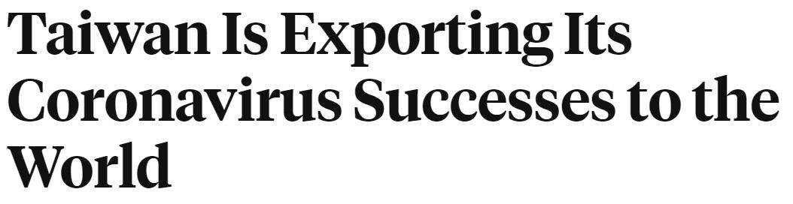

Despite this, Taiwan became leader in world healthcare system

Slide 12
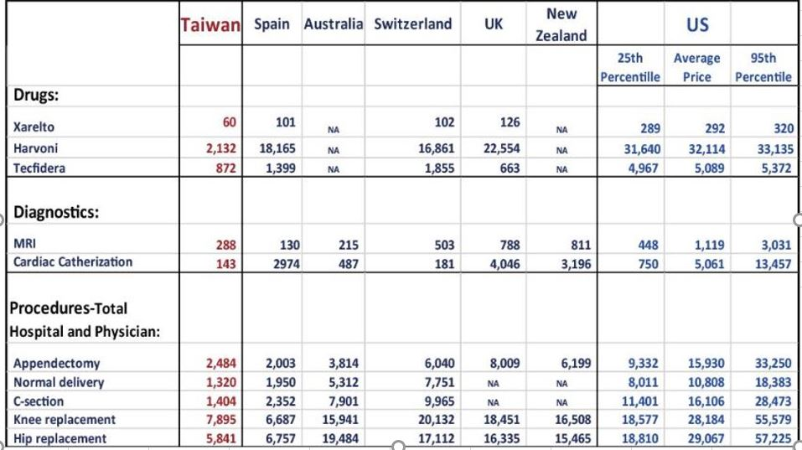
Drugs and procedures cost much less in Taiwan than elsewhere
Sources: Data for OECD countries are based on the 2015 comparative price report by the International Federation of Health Plans.

Slide 13
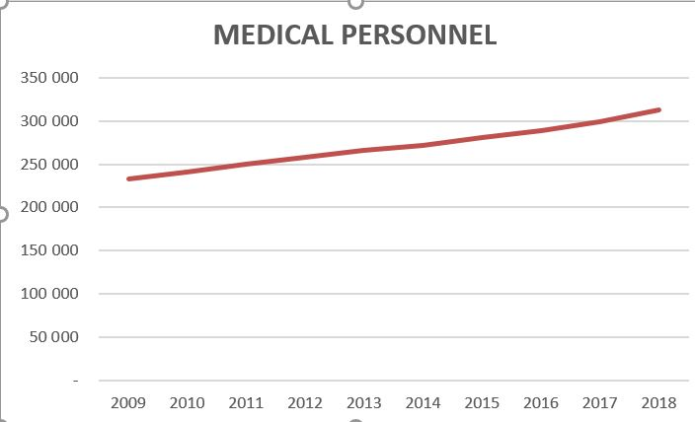
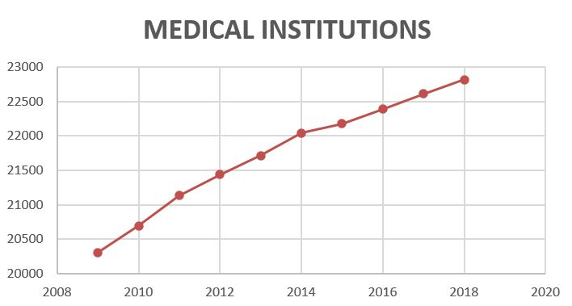
Medical personnel and institutions drastically increased
Sources:
1. Ministry of Health and Welfare
2. Ministry of the Interior

Slide 14
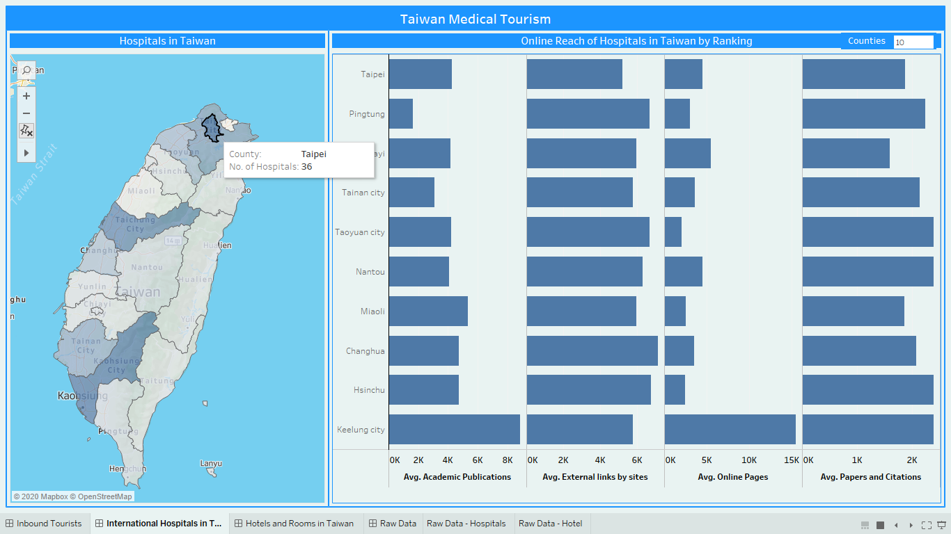
Taipei, having highest number of hospitals, which are also
ranking highly is the first choice for treatments

Slide 15
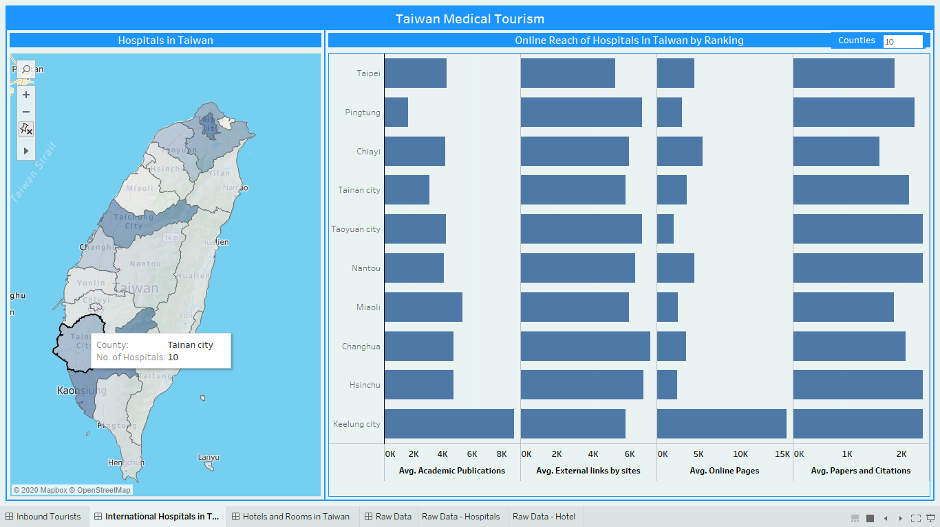
Average ranking of hospitals from Tainan
is among the top 5 and can be our second choice

Slide 16
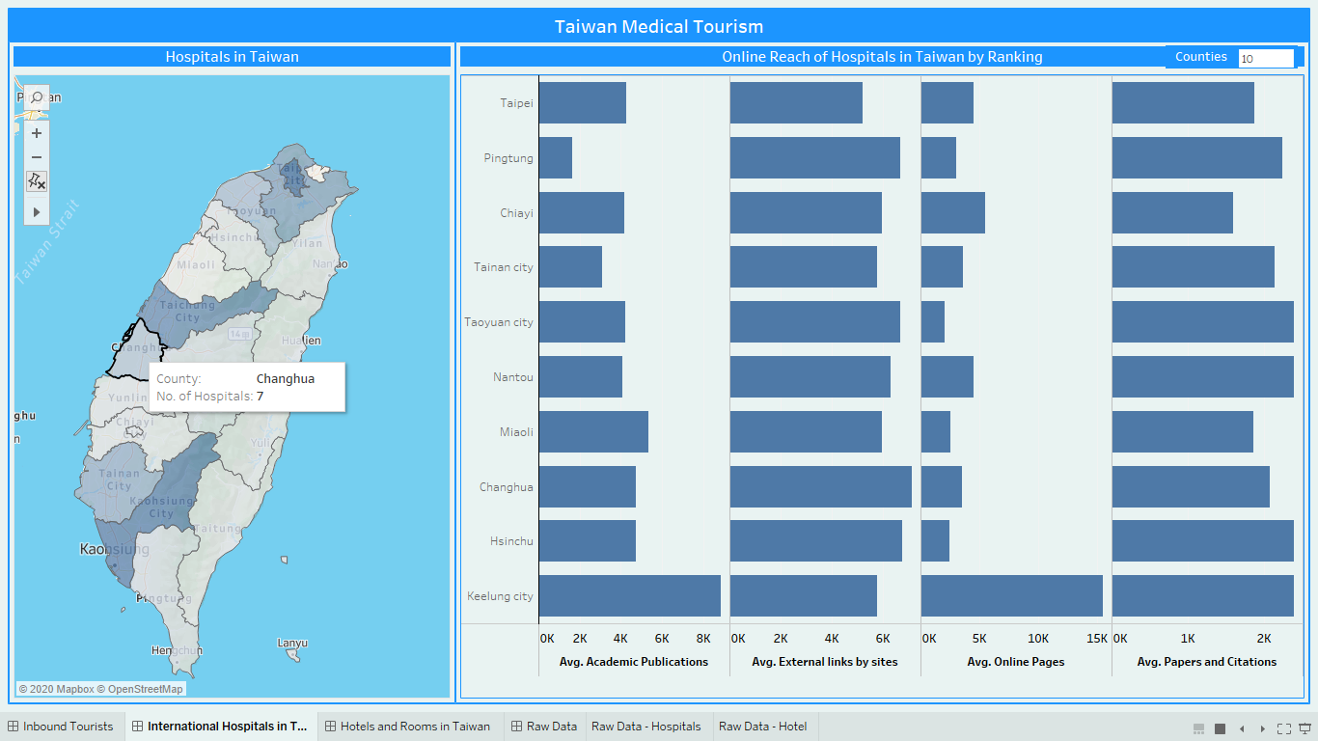
Changhua with just 7 hospitals is ranked in to top 10
and has considerable online presence

Slide 17
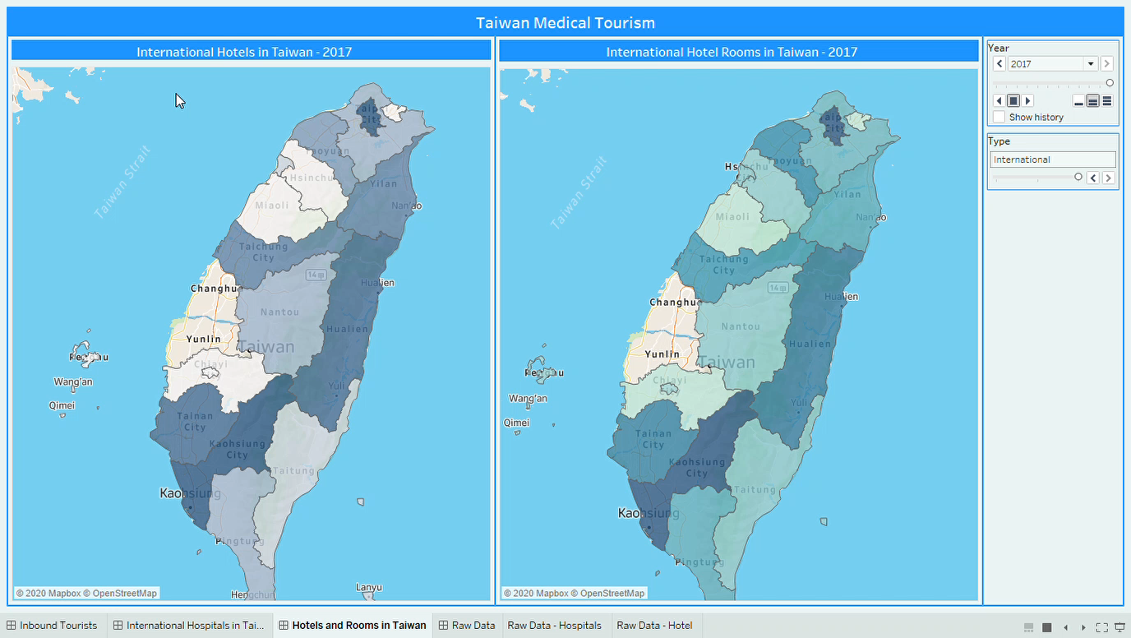
With no competition in Changhua, high profits can be earned

Slide 18
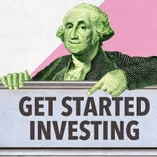
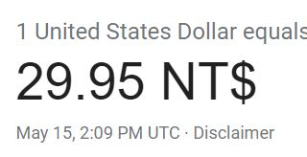

Slide 19

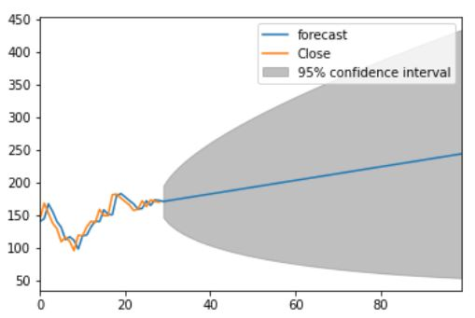
Onyx Healthcare Inc. is a medical IT company. The Company designs, develops, manufactures, and sells medical computing stations, medical panel PCs, bedside infotainment system, nursing carts, MTA (Mobile Telecare Assistant) systems, and other related services.
PRICE TODAY- 169.00 TWD
STOCK PRICE PREDICTION USING ARIMA MODEL

Slide 20
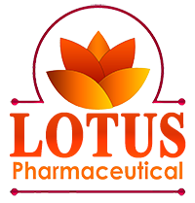
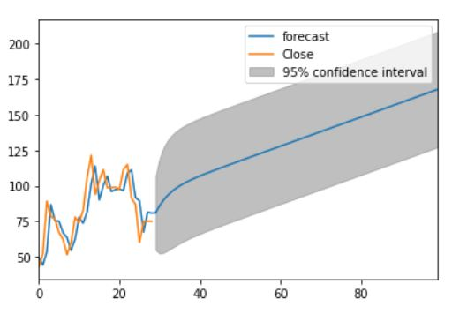
Lotus Pharmaceutical Co., Ltd. manufactures and distributes oral medicine, ointment and injection medicine.
PRICE TODAY-75.00 TWD
STOCK PRICE PREDICTION USING ARIMA MODEL

Slide 21

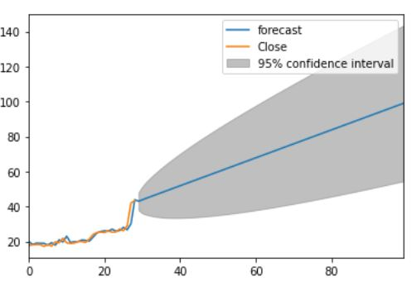
Adimmune Corp. is a human vaccine manufacturer. The company focuses on vaccines, diagnostics, and biological products. Adimmune manufactures vaccines such as the JEV, Tuberculin PPD, Tetanus toxoid, and influenza.
PRICE TODAY- 43.35TWD
STOCK PRICE PREDICTION USING ARIMA MODEL

